Slide 1
What is Bid rigging And why is it illegal
Ania Thiemann
Head of Global Relations
Competition Division, OECD

Slide 2
STRUCTURE OF THE PRESENTATION
Introductory remarks on bid rigging and public procurement
Example of enforcement cases against bid rigging
The OECD Guidelines for Fighting Bid Rigging

Slide 3
MAIN POINTS
Bid rigging can occur in any country and in any market
Bid rigging significantly increases prices of goods and services
Fighting cartels and bid rigging is a top priority of most competition authorities
Effective tools, such as OECD Guidelines, can help fight bid rigging

Slide 4

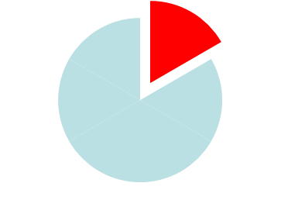
WHY WORRY ABOUT BID RIGGING?
Public procurement accounts for approx 15-20% of GDP in OECD countries
Bid rigging can raise prices significantly (up to 20% or more)
Botswana: 8.8% of projected GDP in 2016/17
POTENTIAL DAMAGES FOR TAX PAYERS
CAN BE SIGNIFICANT !!

Slide 5
Public Procurement Matters
(4.3 trillion EUR spending per year in OECD)
Government procurement as share of GDP and of total govt. expenditures
Source: OECD National Accounts Statistics. (2013)
Notes:
Public Procurement is an important economic and government activity. It involves significant funds and it is used to deliver public services to citizens as well as achieve policy goals such as job creation, innovation, environmental protection or the development of small and medium enterprises (SMEs), so it is a crucial pillar of strategic governance and services delivery for any government.
Public procurement represents an average of 28% of general government expenditure and 13% of GDP in OECD Member Countries, which translates to approximately €4.3 trillion in 2013.
In EU Public Procurement accounts for 18-20% of the GDP.
Other relevant GDP % and % of Govnmt. expenditures:
Colombia:12.5%; 35.8%
Latvia: 11.2%, 31.3%
Russia: 11.5%; 29.7%
South Africa: 16.7%, na
55% of total general government procurement spending on average across OECD countries is carried out at sub-national levels.
Public procurement is also a high-risk area due to the close interaction between private and public spheres
Clear priorities and consistent application, avoiding overlaps and conflicts, remain a challenge

Slide 6
Public Procurement matters…
Public Procurement is a major economic activity
It stands as a crucial pillar of strategic governance for any government body;
It is also a high-risk area due to the close interaction between private and public spheres
Governments face the challenge of ensuring that different priorities are clear, work together and overlaps or conflicts are avoided.
Notes:
Public procurement is a major economic activity, and a core policy tool for a strategic state. Across the OECD and beyond, there is need to deliver quality public services, control public expenditures, ensure sustainable budgets as well as support, through public spending, specific objectives. Governments face the challenge of ensuring that different procurement priorities are clear, work together and overlaps or conflicts are avoided.
There is an increased need for policies based on data, evidence and measurement of performance.

Slide 7
IMPORTANCE OF COMPETITIVE PROCUREMENT
A competitive procurement system will:
  Drive prices to marginal costs
  Will minimise costs for firms and the government
  Will drive innovation, as firms learn from one another and thereby to continuously improve products.
And a public procurement system will accrue benefits to the whole economy as public procurement often involves the supply of key infrastructure (highways, railways, electricity, etc.) for other industries; or benefits.

Slide 8
INTERNATIONAL EXAMPLES
The improvement of procurement procedures led to significant savings in a number of countries (OECD 2003):
  47% saving in the procurement of certain military goods in Columbia
  43% saving in the cost of purchasing medicines in Guatemala
  USD 3.1 ml savings for the Karachi Water and Sewerage Board (Pakistan)
  In the EU, the implementation of the EC Directive on Public Procurement in the period between 1993 and 2002 generated cost savings of between a little less than EUR 5 billion and almost EUR 25 billion.

Slide 9
SURVEYS OF CARTEL OVERCHARGES
Reference | Number of Cartels | Mean Overcharge (percent) | Median Overcharge (percent)
Cohen and Scheffman (1989) | 5-7 | 7.7-10.8 | 7.8-14.0
Werden (2003) | 13 | 21 | 18
Posner (2001) | 12 | 49 | 38
Levenstein and Suslow (2002) | 22 | 43 | 44.5
Griffin (1989) | 38 | 46 | 44
OECD (2003), excluding peaks | 12 | 15.75 | 12.75
Weighted average | 102-104 | 36.7 | 34.6
Source: Connor and Bolotova (2006)

Slide 10
BID RIGGING – THE COSTS
Japan: Prices across 18 tenders declined by approximately 20% after competitive bidding as restored to the procurement process
U.S.: Bid rigging had raised the price paid by the US Department of Defense by 23.1%
S. Africa: Prices of health care products declined by approximately 27% after antitrust intervention
Clarke and Evenett have shown, the resource saving that can be generated by only a marginal reduction in bid rigging on government contracts (e.g. of the order of 1 per cent) is greater than the average annual operating budget of the competition agency in most countries, often by a factor of several times over.

Slide 11
WHAT IS BIDDING?
Bidding is a way to buy or sell goods or services through a tender or auction.
When purchasing, the bid is usually awarded to the low bidder, or a combination of a low bid and some quality or service required by the contracting authority.
Every country has laws and rules establishing procedures.

Slide 12
WHAT IS BID RIGGING?
Any agreement (written or oral) between bidders that limits or reduces competition in a tender.
The agreement may be between a bidder and a potential bidder that does not actually submit a bid.
The agreement may work well and last a long time, or not last long.
In most countries, all bid rigging agreements are illegal, and in some countries criminal.

Slide 13
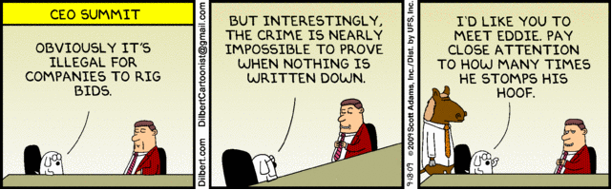

Slide 14
BID RIGGING – THE CAUSES
Firms’ conduct - Agreements between competitors:
  Agreement on who will win the bid
  Agreement on prices
    Agreement to raise, lower, or maintain prices
    Agreement not to negotiate on price
    Agreement to limit discounts / rebates
    Agreement on price formulas or guidelines
  Agreement on who will bid for certain customers (government agencies) or in certain geographic areas
Regulatory framework which might:
  Increase transparency
  Increase participation costs
  Limit international competition
  Favor joint bidding and sub-contracting

Slide 15
BID RIGGING - COMMON FORMS
Cover bidding A competitor agrees to submit a bid that is higher than the bid of the designated winner or agrees to submit a bid that contains terms that are known to be unacceptable to the buyer.
It is the most common form of bid rigging as it gives the appearance of genuine competition.
Bid suppression One or more companies agree to refrain from bidding or to withdraw a previously submitted bid.
Bid rotation Conspiring firms continue to bid, but they agree to take turns being the winning (i.e., lowest qualifying) bidder.
Market allocation Competitors carve up the market and agree not to compete for certain customers or in certain geographic areas.

Slide 16
BID RIGGING V. CORRUPTION
Corruption can involve only 1 company paying a bribe to a government official
Bid rigging must involve at least 2 companies. They must agree on how to avoid competition.
But, corruption can involve bid rigging.

Slide 17
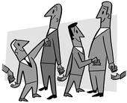
A vicious circle
Collusion
High prices
Bribes and
kick-backs
Corruption
Inefficient Procurement

Slide 18
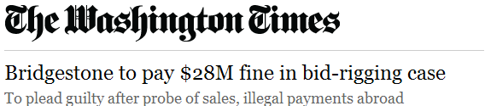
TYPICAL EXAMPLES
Bridgestone Corp. agreed Thursday to plead guilty and pay a $28 million fine for its role in conspiracies to rig bids and make corrupt payments to government officials in Latin America in the sale of marine hose and other industrial products manufactured by the company and sold globally.
Acting Assistant Attorney General Sharis A. Pozen, who heads the Justice Department’s Antitrust Division,...charged the Tokyo-headquartered firm with conspiring to violate the Sherman Act and the Foreign Corrupt Practices Act (FCPA).

Slide 19

TYPICAL EXAMPLES
Nearly two years after it suspended aid for a health project in India, the World Bank has again detected fraud and corruption in five health projects aided by it here, prompting the government to promise "exemplary punishment" to those found guilty.
The corruption has been detected in five health projects worth a total of 568 Million USD.
The report found indications of fraudulent and corrupt practices related to procurement such as collusive behaviour, bid-rigging, bribery and manipulated bid prices.

Slide 20
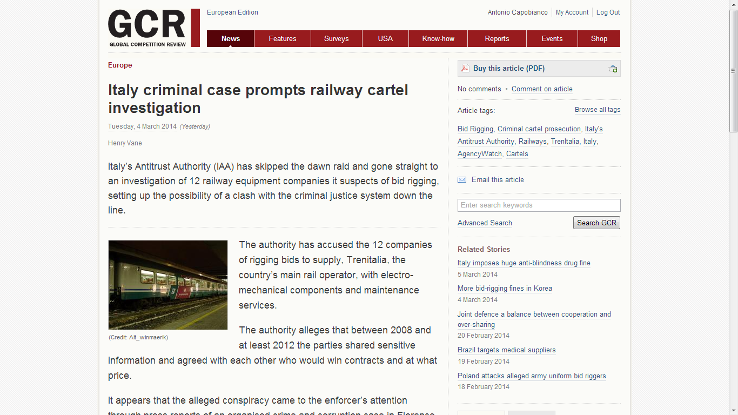
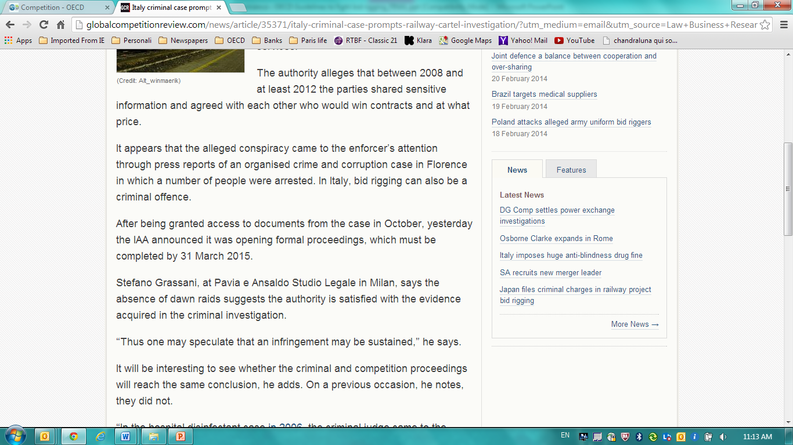
TYPICAL EXAMPLES

Slide 21
HOW TO FIGHT BID RIGGING EFFECTIVELY
Effective cartel laws and regulations
Effective leniency program
Effective enforcement procedures and institutions
Effective sanctions
Other ways:
Raise awareness of procurement officials and bidders concerning the risks of bid rigging (Checklists and Guidelines)

Slide 22
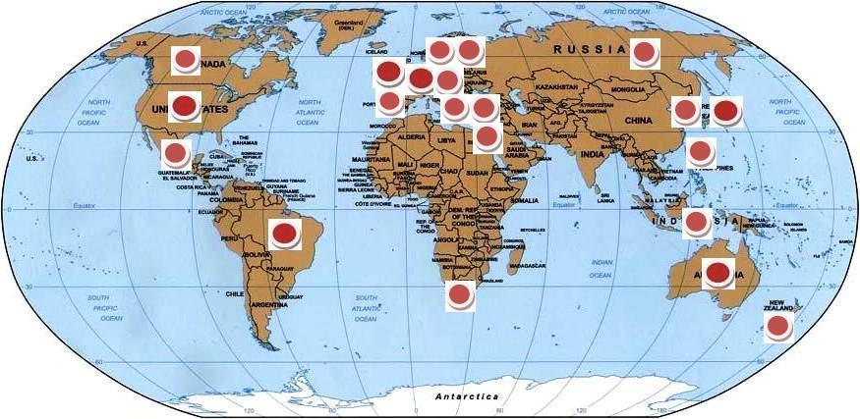
BID RIGGING CASES FROM AROUND THE WORLD

Slide 23
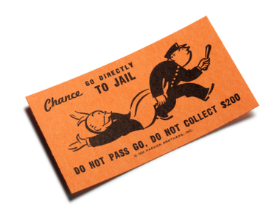
Bid Rigging – Sanctions
Criminal law systems (US, UK, Ireland, etc.)
Hard core cartels (includes bid rigging) are a criminal offence
Fines and jail sanctions
Administrative law systems (EU)
Fines
Mixed systems (Germany, Austria, Italy …)
Bid rigging in public procurement actions is a criminal offence
Fines and jail sanctions
All other cartels subject to administrative fines
Co-operation in the prosecution with
Public prosecutors
Police
Other government agencies
Courts

Slide 24
UK - CONSTRUCTION BID RIGGING
103 construction companies were fined a total of 143 million Euros for colluding on building contracts.
Illegal conduct impacted 199 tenders for 6 years.
More than 220 million Euros in projects affected, including schools and hospitals as well as numerous private projects.
The OFT also received evidence of cover bidding implicating many more companies on thousands of tender processes, but focused its investigation on the alleged infringements.
Cover bidding strategies were used and compensation paid to losing bidders ranging from 3.000 – 70.000 Euros.

Slide 25
THE NETHERLANDS – CONSTRUCTION CARTEL
Sector | Infringement | Number of Firms Fined | Total Fines
Highways and roads, buildings | Complementary bidding and compensation | 611 | €71 million
Concrete products | Market division | 50 | €12.8 million
Horticulture services – “building parks” | Market division and cover bidding | 56 | €3 million
Installation of cables and pipes | Market division and cover bidding | 72 | €12 million

Slide 26



OECD Guidelines - 2009

Slide 27

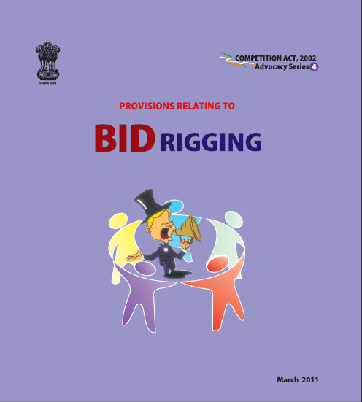
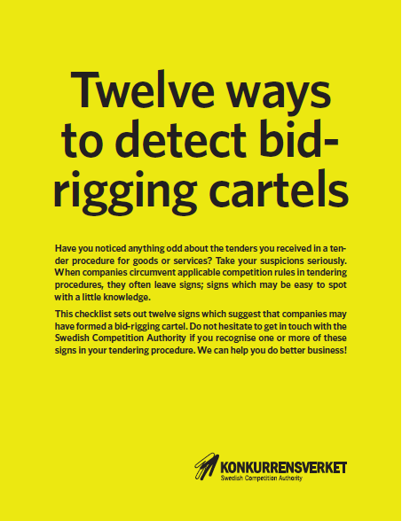
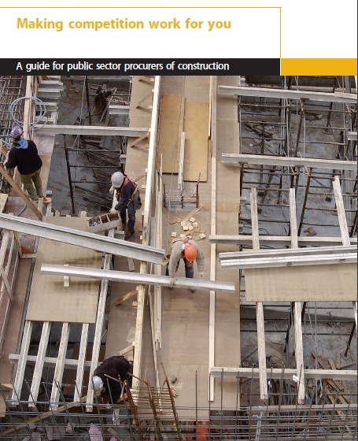

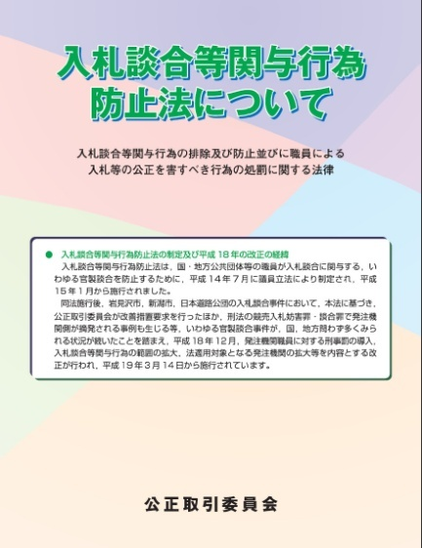
Guidelines of Competition Authorities

Slide 28
OECD GUIDELINES FOR FIGHTING BID RIGGING
Source
Best practices in OECD countries
Better tender design
Help procurement officials design public tenders to reduce bid rigging
(Design Checklist)
Tougher law enforcement
Help procurement officials detect bid rigging when it occurs (Detection Checklist)

Slide 29
CHECKLIST FOR DESIGNING TENDERS
Learn about the market and about your suppliers
Maximise participation of potential bidders
Define requirements clearly and avoid predictability
Reduce communication among bidders
Raise awareness of the risks of bid rigging, provide training

Slide 30
CHECKLIST FOR DETECTING BID RIGGING
Procurement officials should be alert for:
Opportunities that bidders have to communicate with each other
Relationships among bidders (joint bidding and sub-contracting)
Suspicious bidding patterns (e.g. ABC, ABC) and pricing patterns
Unusual behavior
Clues in documents submitted by different bidders

Slide 31
WHERE TO FIND THE OECD GUIDELINES?
Web link: www.oecd.org/competition/bidrigging
Translations available in 26 languages!

Slide 32
What is Bid rigging And why is it illegal
Ania Thiemann
Competition Division, OECD

